Slide 1
Unit - 1
Spreadsheet functions to organize data Part-1

Slide 2
Cell reference styles
We can do the styling of cell references as well.
There is an option available in the Home Tab known as Cell styles.
When you will click on that, you will get so many options that can be applied on the cells.

Slide 3
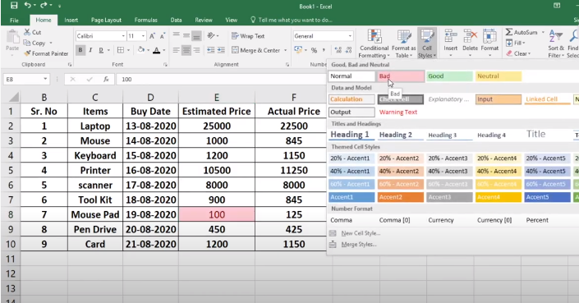

Slide 4
There are three types of cell references:
Relative
Absolute
Mixed

Slide 5
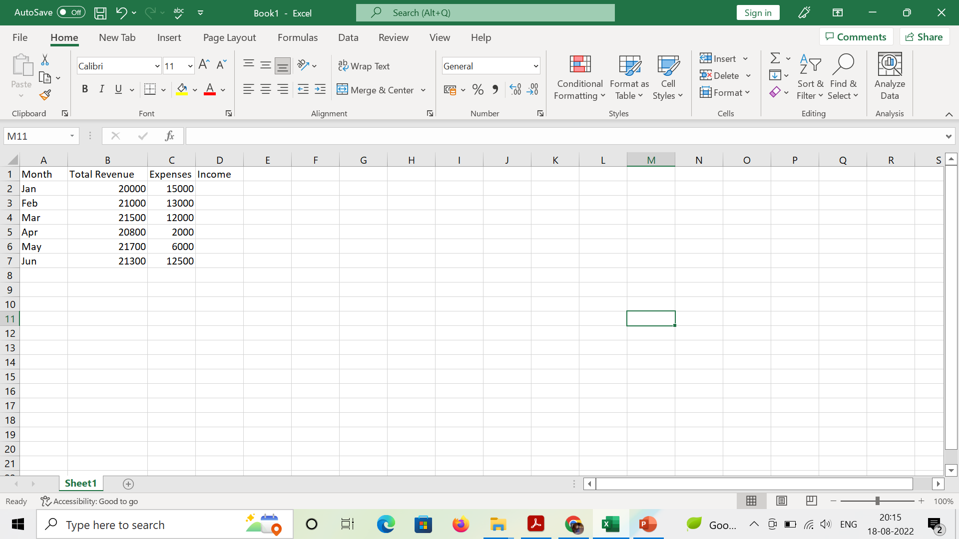
Relative Reference
Notes:
In this sheet, total revenue and Expenses are given. To find the Income, we need to apply the formula.

Slide 6
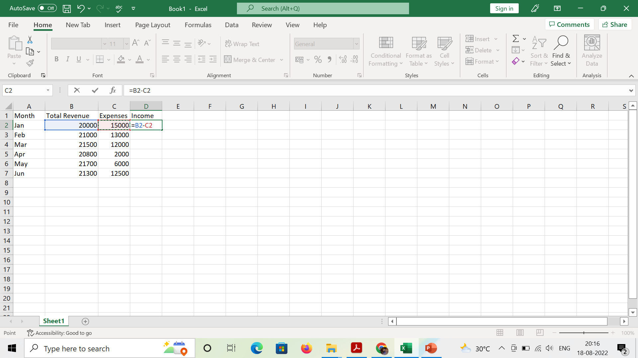
Notes:
Enter the formula and press enter key to apply the formula to the cell. Now to apply the formula to all the cells, select the cell and drag it down. Formula will be applied to all the cells

Slide 7
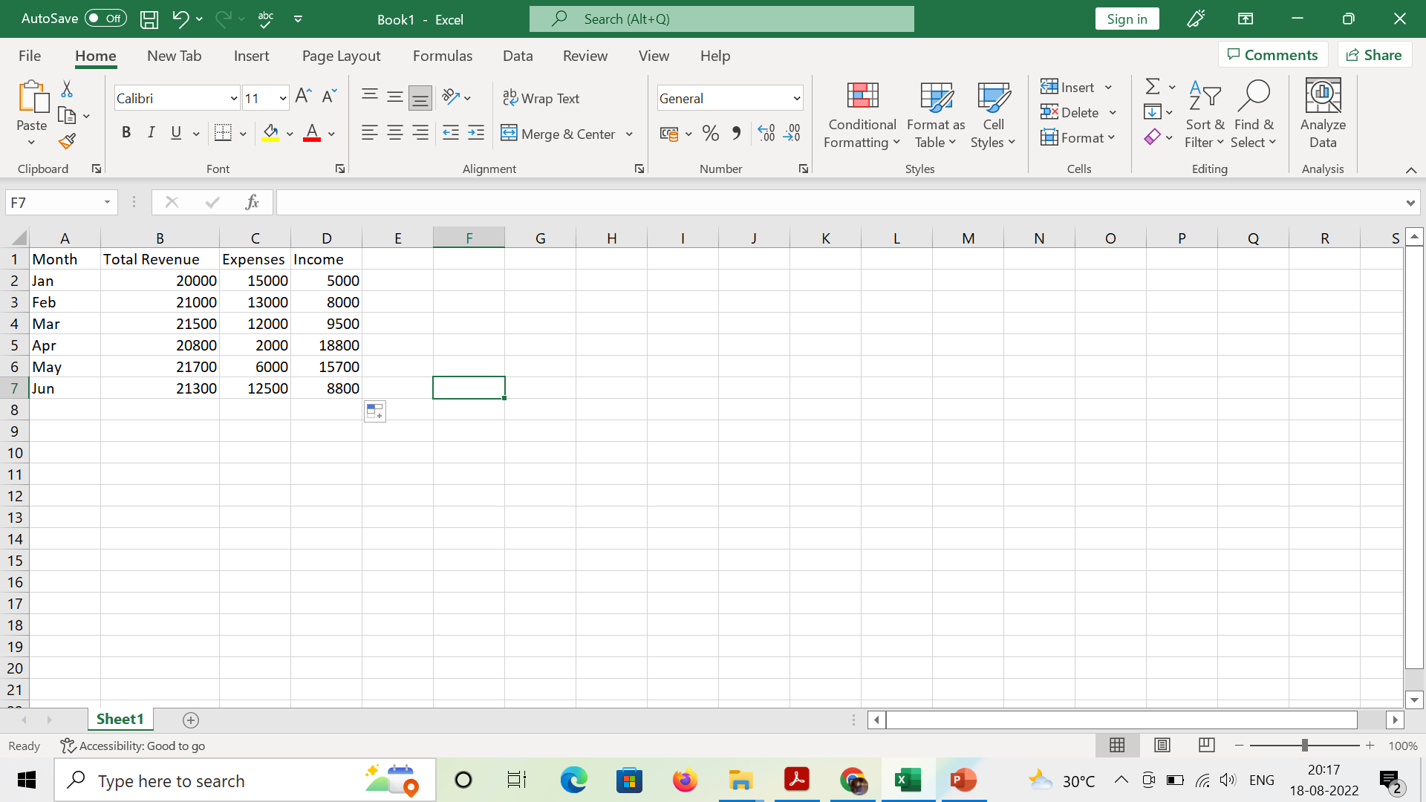

Slide 8
There is also another way of relative reference
Select the column in which you want to apply the formula.
Then add the formula in the first cell and press ctrl+Enter.

Slide 9
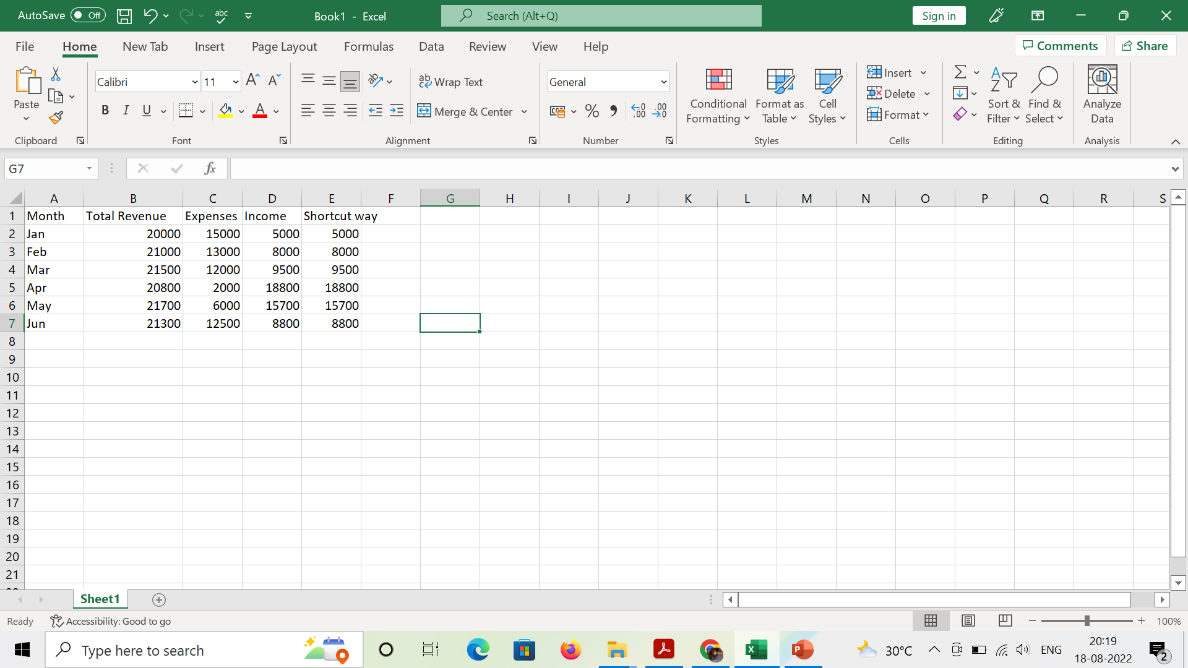

Slide 10
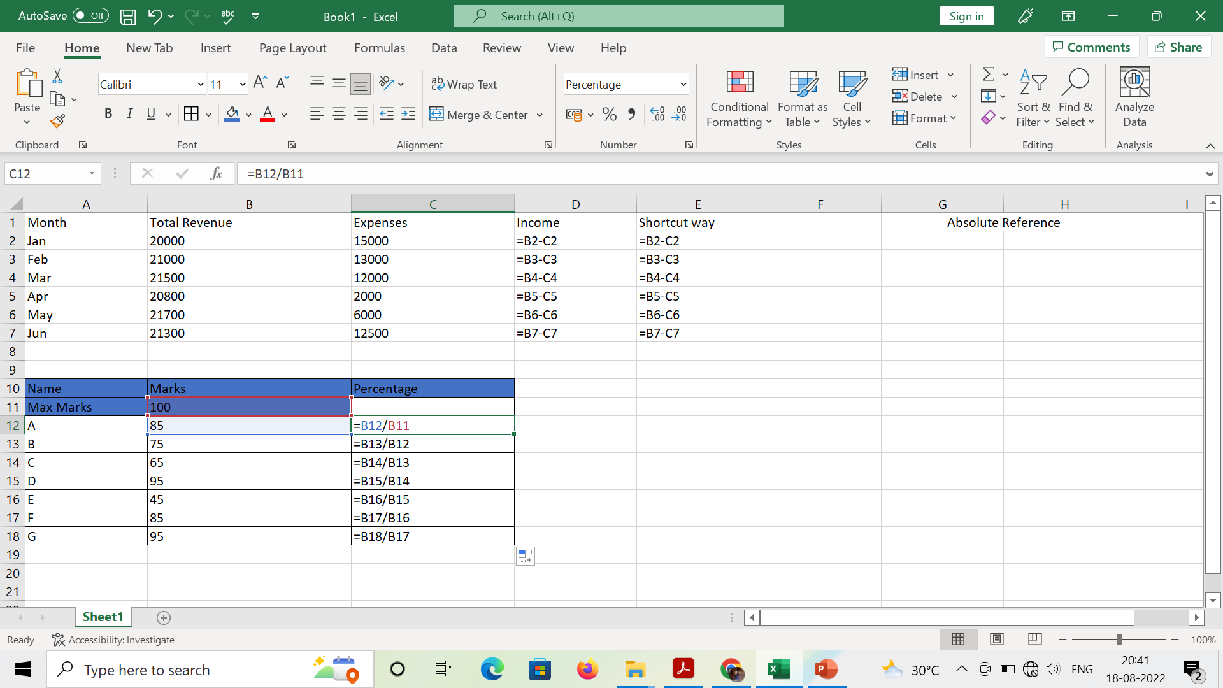
Absolute Reference
Notes:
Here we are finding the percentage marks. But we will get wrong answer as it is using by default relative reference

Slide 11
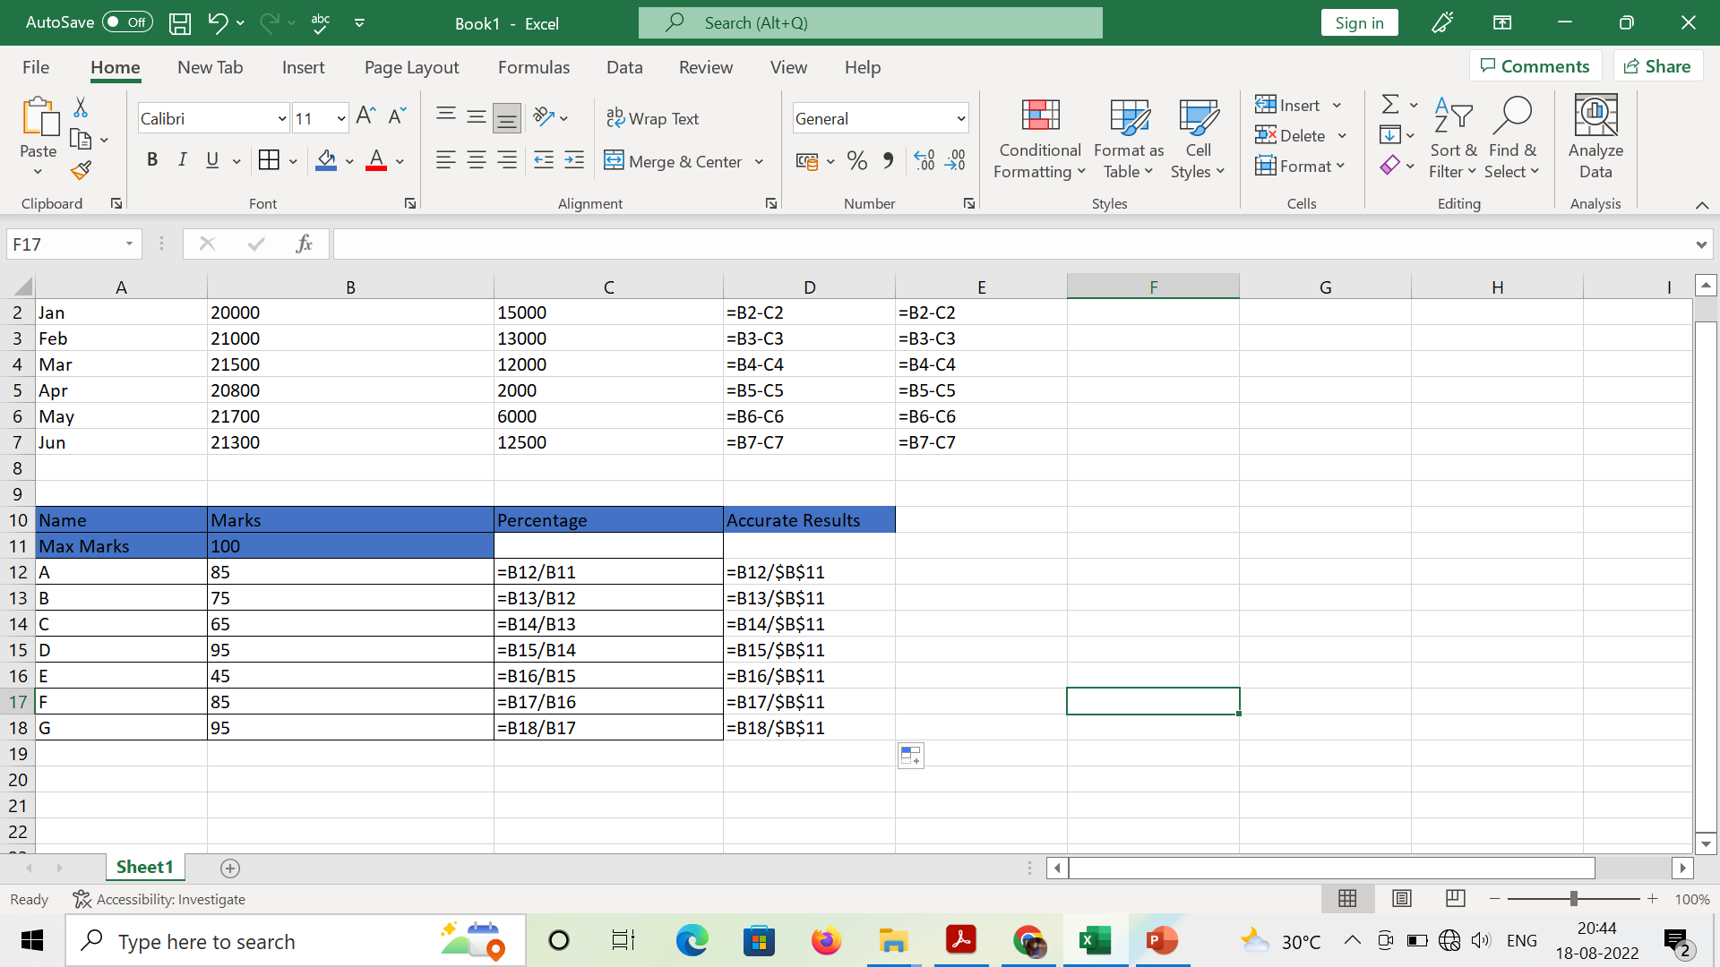
Notes:
To make absolute reference, we have to fix the cell containing 100. So that every cell must be divided by that cell having 100

Slide 12
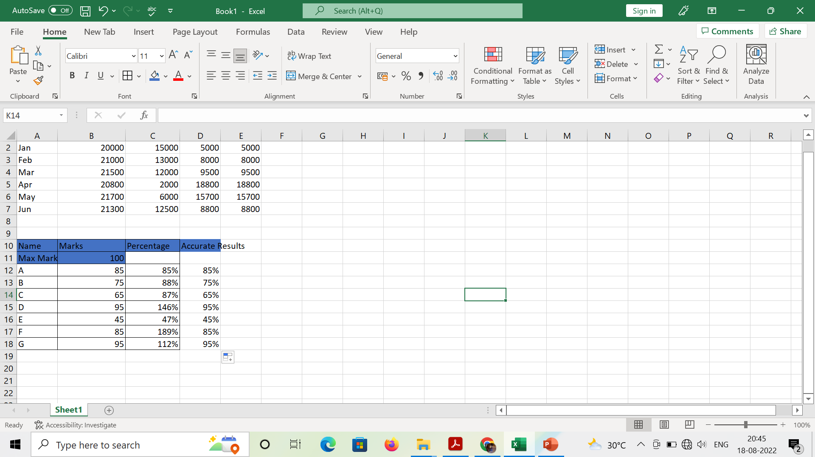
Notes:
These are the correct results

Slide 13
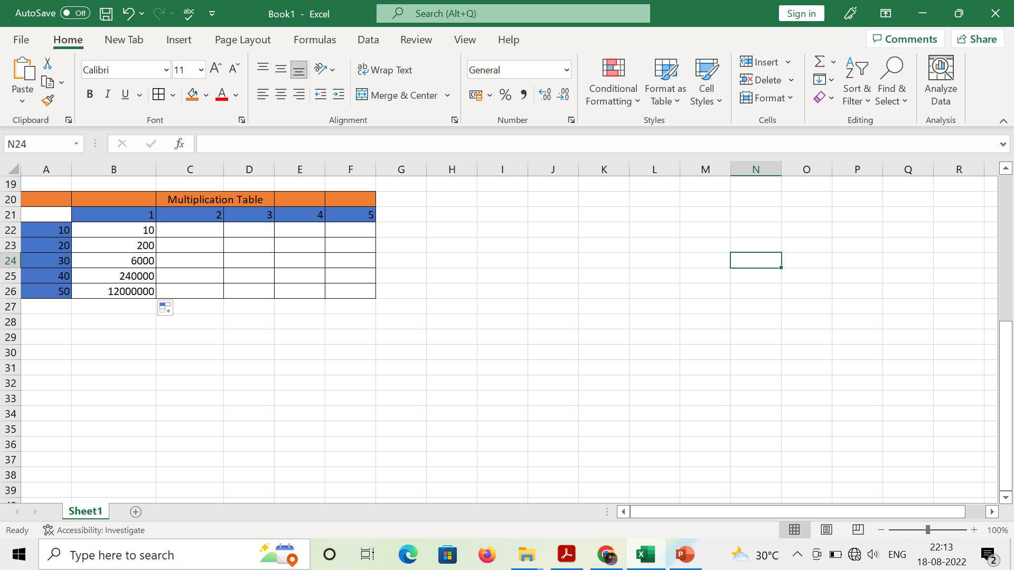
Mixed Reference
If we want to fix both row and column values, in that case we have to use mixed reference.

Slide 14
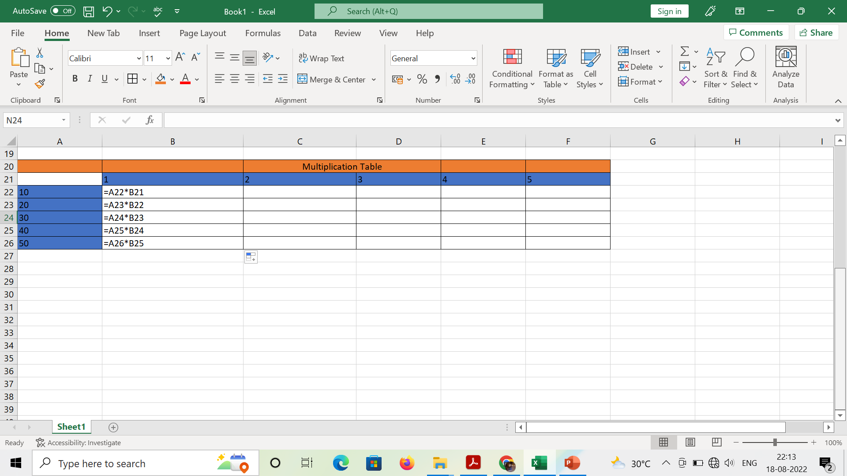
Notes:
Here, we are multiplying a22 and b21 so, we are getting 10. But for other cells, answer is wrong. Because we have to multiply b21 with every cell

Slide 15
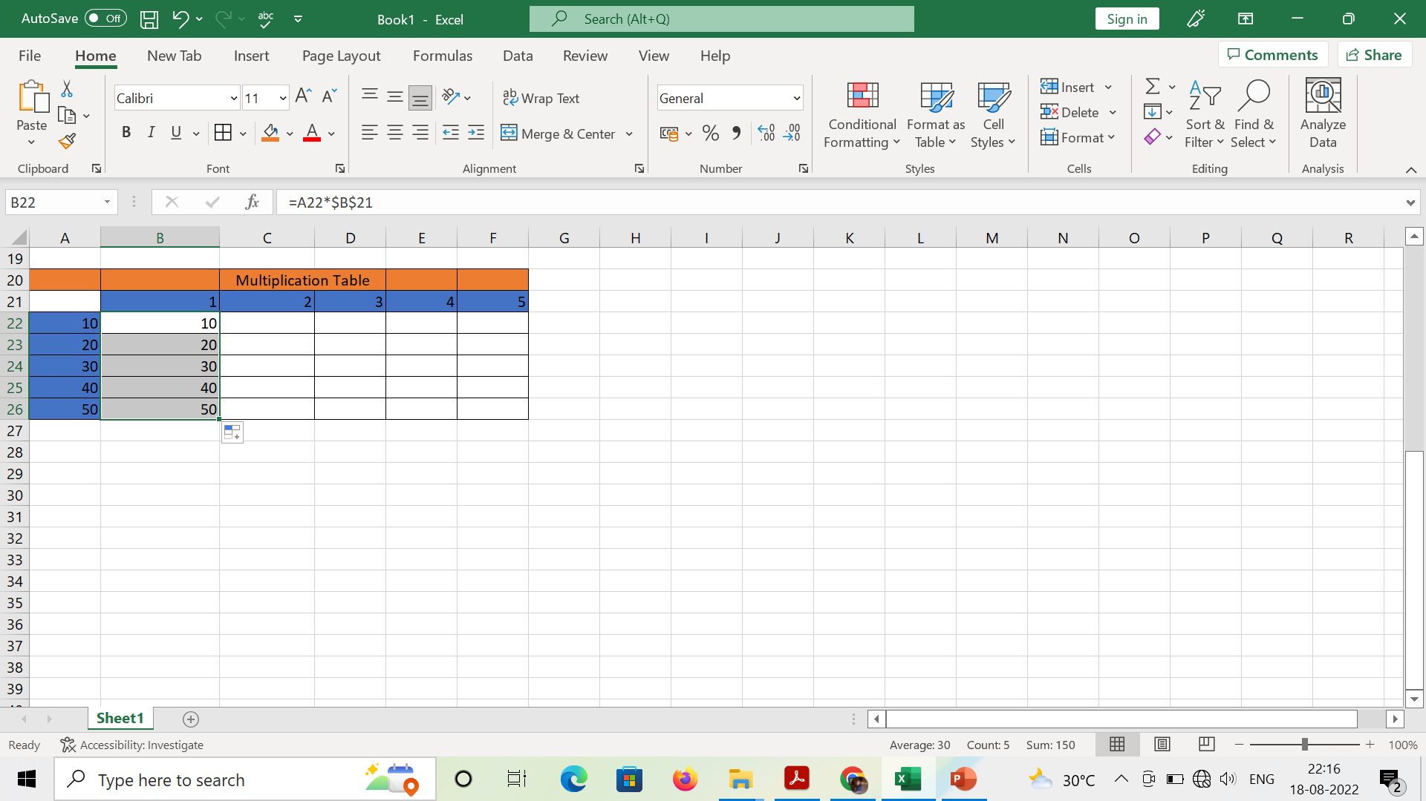
Notes:
Now we are getting correct values bcoz we have to fix cell B21

Slide 16
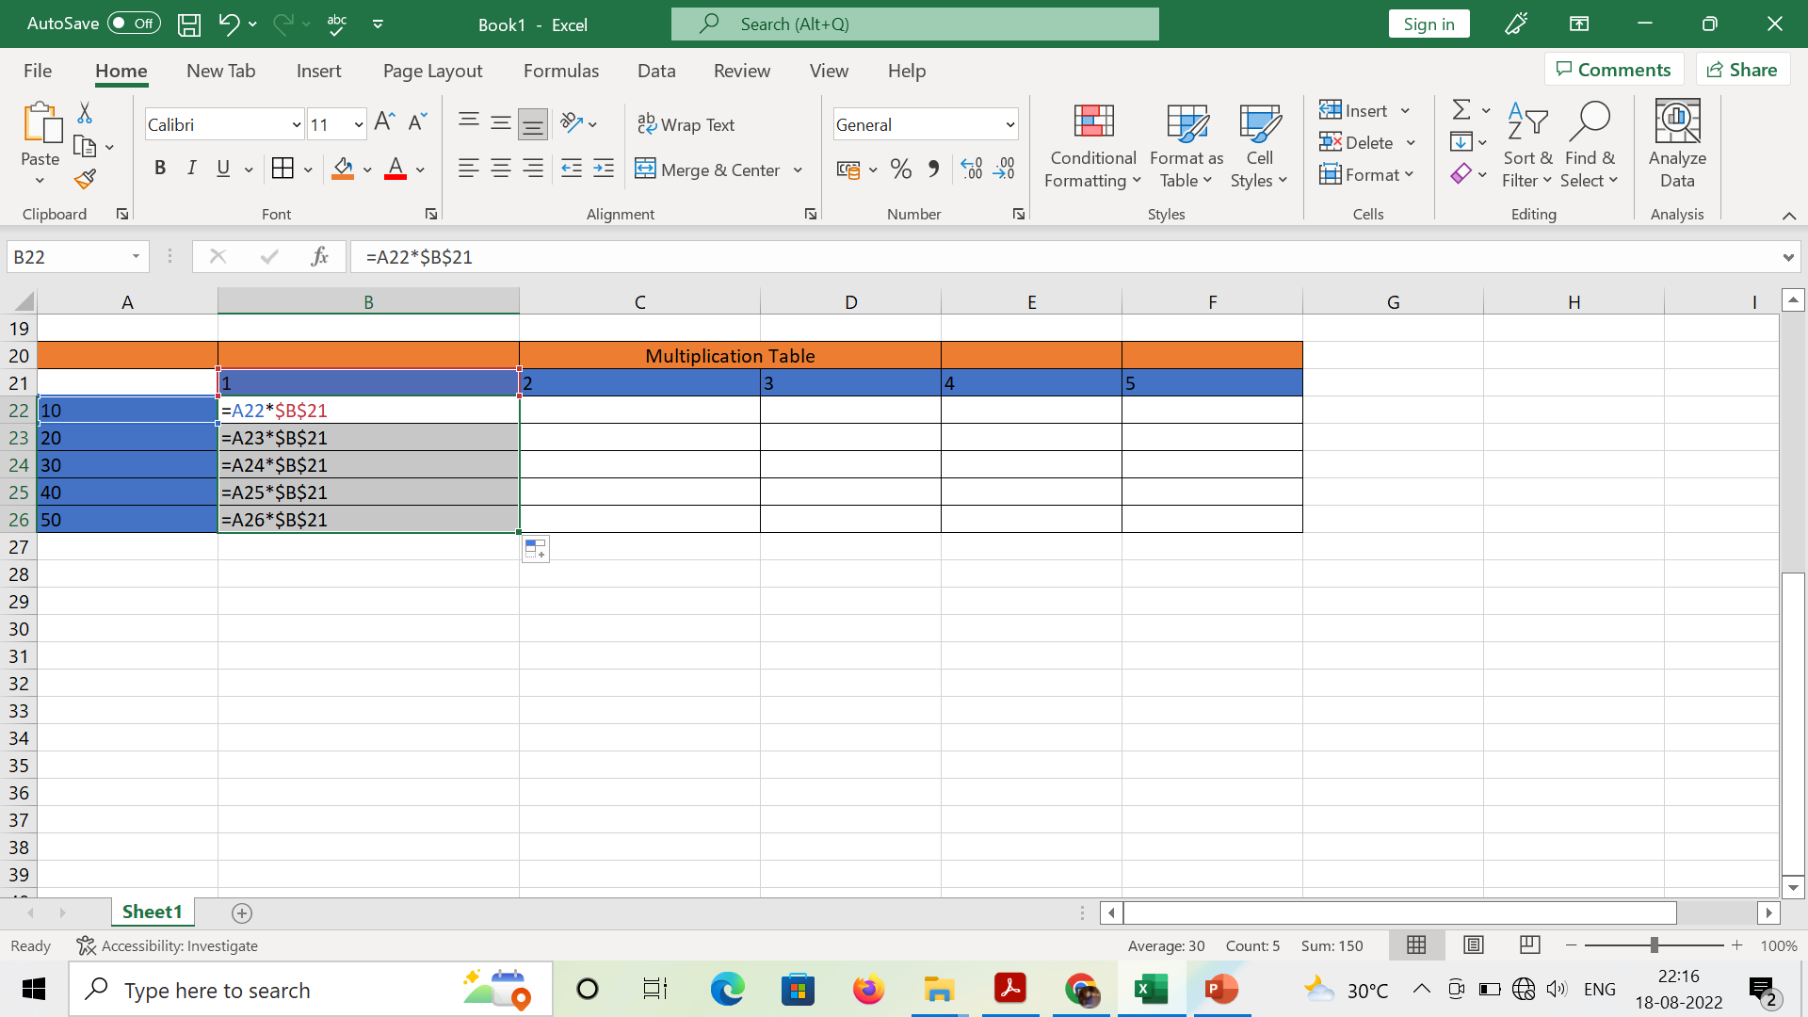

Slide 17
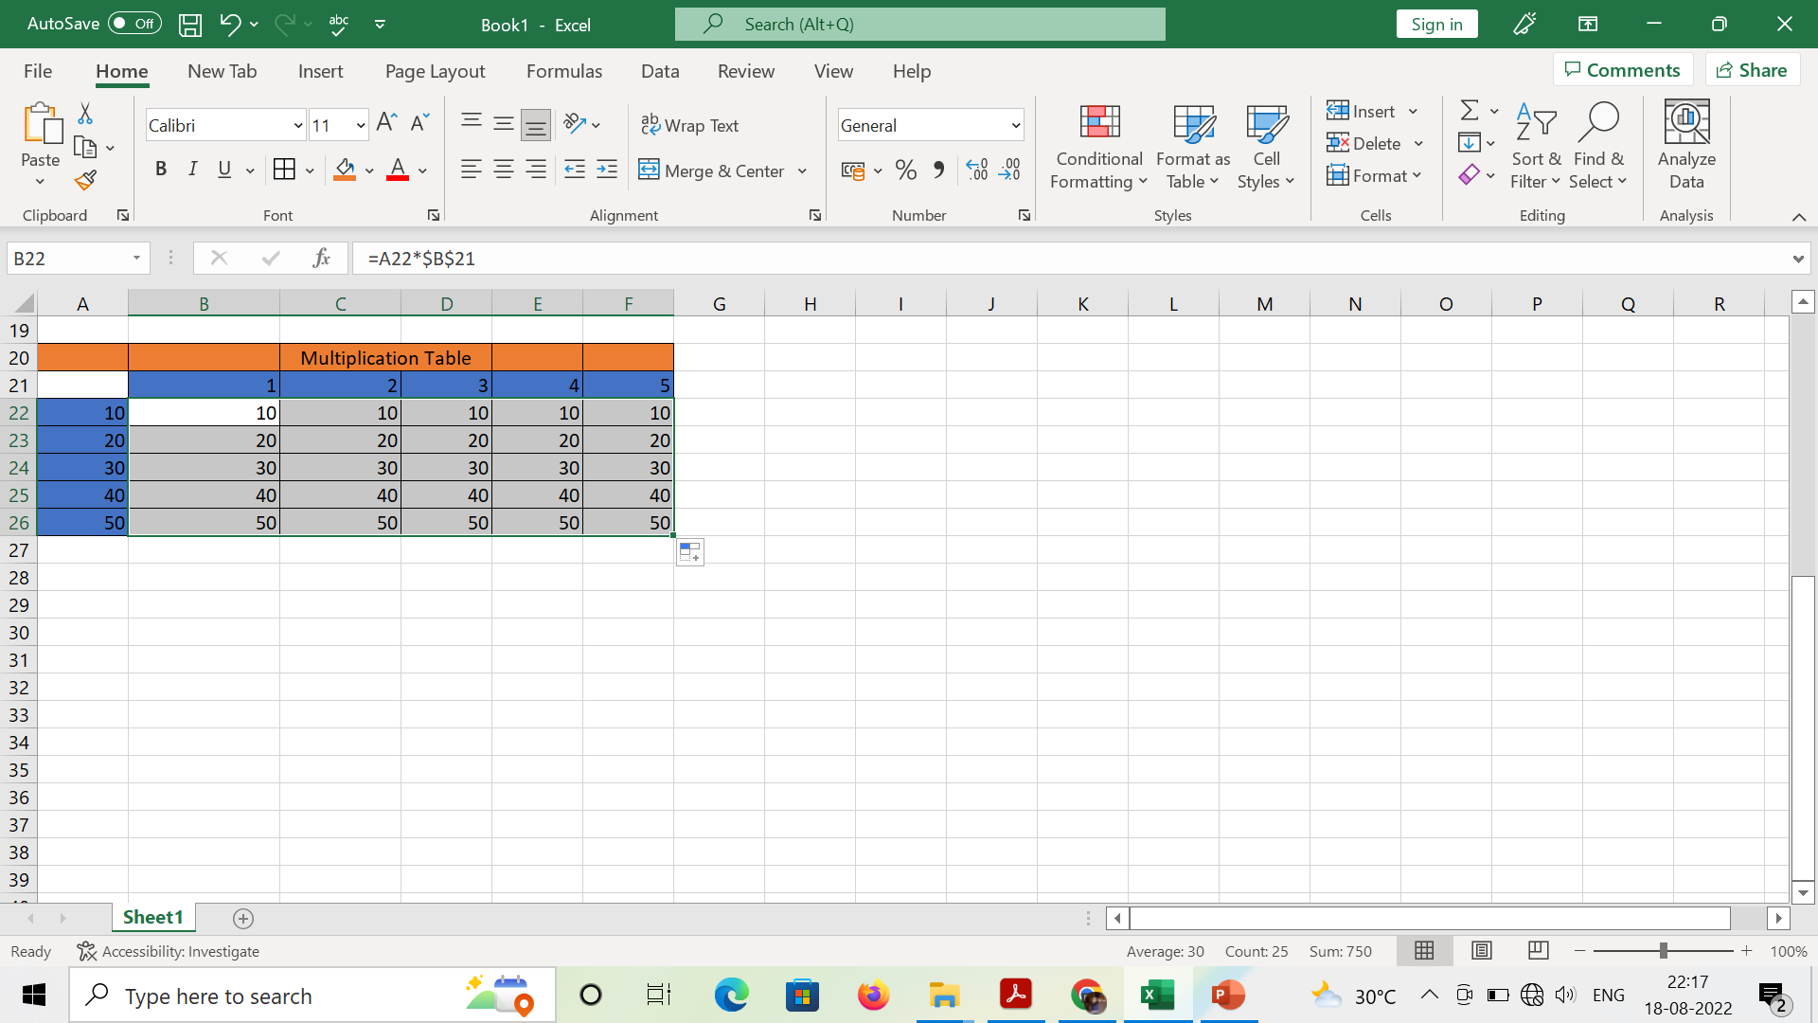
Notes:
So for whole table it is giving wrong answer. It means we have to fix row and column both. It is known as mixed reference

Slide 18

Notes:
This is mixed reference

Slide 19
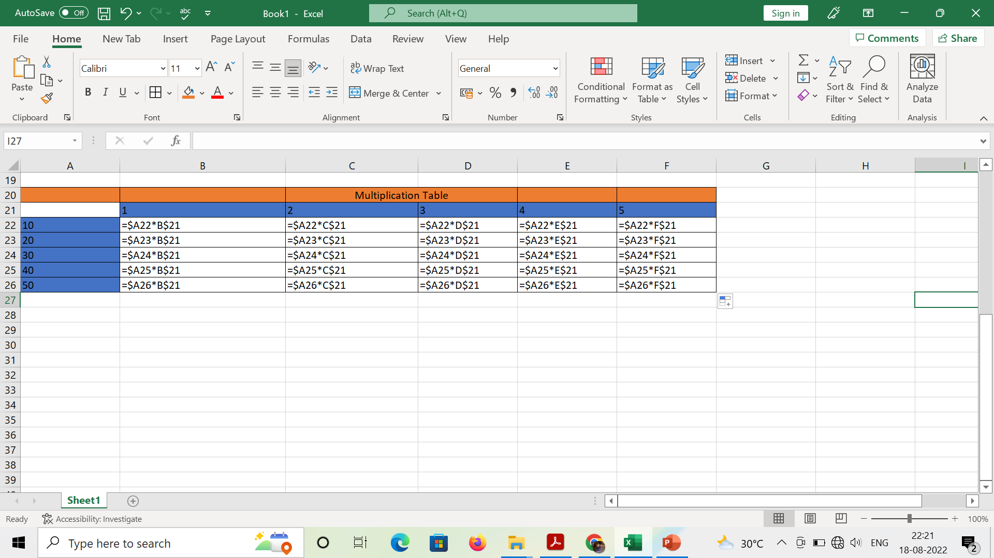

Slide 20
Creating and Working with formulas
FORMULAS IN EXCEL is an expression that operates on values in a range of cell addresses and operators. For example, =A1+A2+A3, which finds the sum of the range of values from cell A1 to cell A3. An example of a formula made up of discrete values like =6*3.
=A2 * D2 / 2
HERE,
"=" tells Excel that this is a formula, and it should evaluate it.

Slide 21
"A2" * D2" makes reference to cell addresses A2 and D2 then multiplies the values found in these cell addresses.
"/" is the division arithmetic operator
"2" is a discrete value
We will work with the sample data for the home budget to calculate the subtotal.
Create a new workbook in Excel
Enter the data shown in the home supplies budget above.
Your worksheet should look as follows.

Slide 22
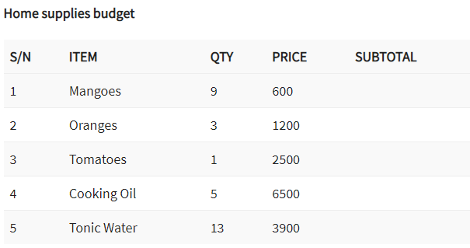

Slide 23
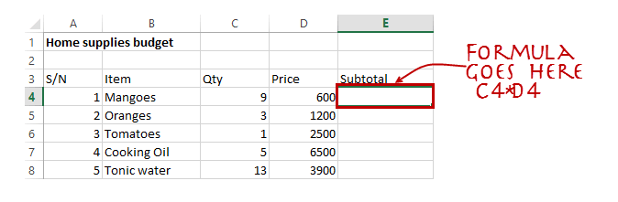

Slide 24
Set the focus to cell E4
Enter the following formula.
=C4*D4
HERE,
"C4*D4" uses the arithmetic operator multiplication (*) to multiply the value of the cell address C4 and D4.

Slide 25
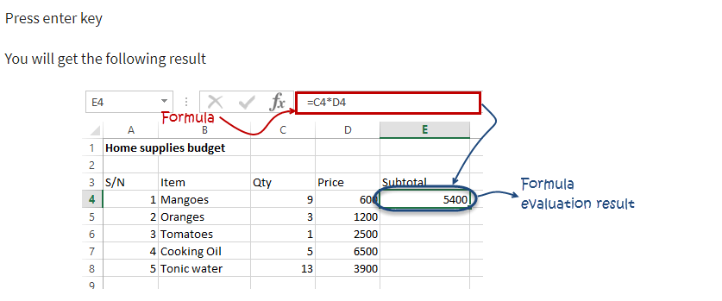

Slide 26
Mistakes to avoid when working with formulas in Excel
Remember the rules of Brackets of Division, Multiplication, Addition, & Subtraction (BODMAS). Using this rule, we can write (A2 * D2) / 2. This will ensure that A2 and D2 are first evaluated then divided by two.
Excel spreadsheet formulas usually work with numeric data; you can take advantage of data validation to specify the type of data that should be accepted by a cell i.e. numbers only.

Slide 27
To ensure that you are working with the correct cell addresses referenced in the formulas, you can press F2 on the keyboard. This will highlight the cell addresses used in the formula, and you can cross check to ensure they are the desired cell addresses

Slide 28
Function
FUNCTION IN EXCEL is a predefined formula that is used for specific values in a particular order. Function is used for quick tasks like finding the sum, count, average, maximum value, and minimum values for a range of cells.
SUM for summation of a range of numbers
AVERAGE for calculating the average of a given range of numbers

Slide 29
COUNT for counting the number of items in a given range.

Slide 30
The importance of functions
Functions increase user productivity when working with excel.
Let’s say you would like to get the grand total for the above home supplies budget.
To make it simpler, you can use a formula to get the grand total.
Using a formula, you would have to reference the cells E4 through to E8 one by one.
You would have to use the following formula.
= E4 + E5 + E6 + E7 + E8

Slide 31
With a function, you would write the above formula as
=SUM (E4:E8)
As you can see from the above function used to get the sum of a range of cells, it is much more efficient to use a function to get the sum than using the formula which will have to reference a lot of cells.

Slide 32
Text Functions
Text functions are helpful when we seek to only get a portion of the information contained within a cell or we are trying to combine information contained in multiple cells.
LOWER, UPPER, and PROPER
Information may be in upper cases, lower cases, or a combination of both. To make clean tables and charts can require formatting or use of the following functions:

Slide 33
LOWER – This function returns text values in a cell in all lower case.
UPPER – This function returns text values in a cell in all upper case.
PROPER – This function returns text values in a cell with the each of the first word capitalized.

Slide 34


Slide 35
CONCATENATE
CONCATENATE is helpful to combine information contained in separate cells into one cell.
The function contains arguments referencing the cells containing the information.
The example below shows how the function returns values. In the first example, first name and last name is combined, but look closely because there isn’t a space. By adding to the

Slide 36
argument by including spaces (“ “), commas (“, “), and other desired punctuation or words (“ of “) the appropriate desired value can be returned.

Slide 37
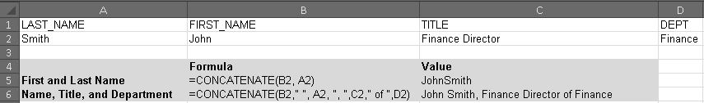

Slide 38
LEFT, RIGHT, and MID
These functions are helpful to extract a portion of a larger string.
The example below shows is an account structure.
The first four digits represent the department/division. In order to retrieve the first four digits, we use the left function.
The first argument identifies the cell containing the account information (A2

Slide 39
) and the tooltip identifies how many digits from the left do we want to extract (4).
The RIGHT function follows a similar structure. In the example below, the last 5 digits represent the object.
Thus, the argument identifies the cell containing the account information (A2) and the number of digits from the right we want to extract (5).

Slide 40
The MID function requires more details. Similar to LEFT and RIGHT, the argument identifies the cell containing the account information (A2).
The first tooltip identifies which digit to start the extraction (5 to represent the fifth digit in the account string) and second tooltip identifies the number of digits to extract (5).

Slide 41


Slide 42
LEN and TRIM
LEN is helpful to return the length of a string in a cell. The function contains one argument and that is the cell of inquiry.
Note from the example below that Excel calculates extra spaces in the string in the length number. For example, the name Eli is shown as having a length of 5 and Tina has a length of 6.

Slide 43
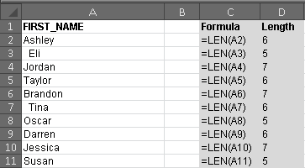

Slide 44
TRIM
One common use of the TRIM function is to remove extra spacing. Following the example above, the TRIM function is used below to remove the extra spacing, which shortens the length of the cell. The function contains one argument and that is the cell of inquiry.

Slide 45


Slide 46
TEXT and VALUE
When exporting data, numbers can sometimes appear with formatting issues or come in as text rather than number.
TEXT converts a numeric value to text. There are also different ways users can specify the display formatting by using special format strings.
The first example below shows a figure with many decimals, but we want only the whole number.

Slide 47
Thus, the TEXT function is used to identify the cell that contains the information (A2) and specifies it should be the nearest whole number (“0”).
In the second example, the figure is 21.3, but we want it to display as a dollar value. Using the TEXT function, A3 is identified as the cell that contains the information and “$0.00” is specified as the display.

Slide 48


Slide 49
Above in A4 contains a number, but Excel recognizes it as text (a simple way to determine that Excel has identified this as text is the green triangle on the upper left corner).
If the figures are recognized as text instead of numbers, then calculation and analysis cannot be performed accurately.
The VALUE function contains one argument, which identifies the cell that contains the information (A4).

Slide 50
Date and Time Functions
DATE
This function is useful when information related to year, month, and date are in separate cells and the preference is to have the date in one cell.

Slide 51


Slide 52
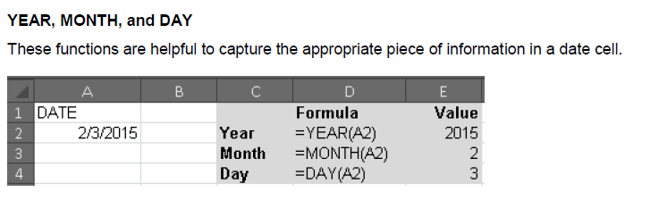

Slide 53
WEEKDAY
This function returns the day of the week for a given date.
Eg:-
9/10/2021
=weekday(a1)
6th day

Slide 54
